Slide 1


Ivan Krnić
Director of Engineering
CROZ
@ikrnic

Slide 2

Our DevOps journey @ CROZ
Context
Professional services company focused on IT service delivery
The speed of innovation higher than ever, the technology more complex than ever
Challenge
Delivery teams losing pace with technology, low knowledge sharing, lots of “reinventing the wheel”, not enough standardization, expensive delivery process
Hypothesis
Different way of structuring teams and coordinating work could help
Result
Better collaboration and knowledge sharing, lower cognitive load on existing teams, additional leverage for organizational improvements, improved business results

Slide 3

Turning point #1
(2010.)
Rapid growth
2008-2010 Deloitte Technology Fast EMEA/Central Europe
Doubled in headcount
Downside
Friction in delivery process, new colleagues, low on skills and knowledge
Solution
Moving from project teams to stable, long-standing cross-functional teams

Slide 4
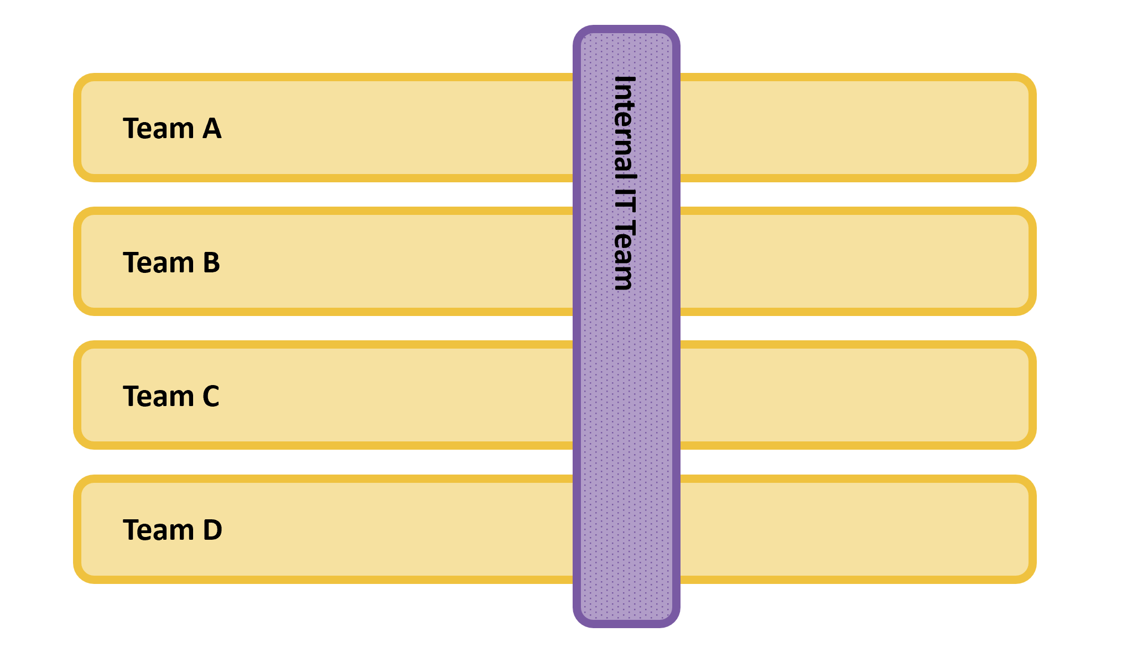
Cross-functional teams with
end-to-end ownership of functionalities, delivery process and infrastructure

Slide 5
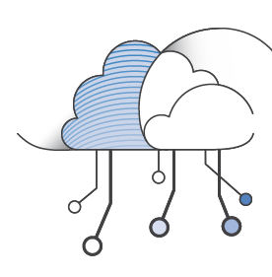
Then cloud native happened!
Upsides
Cloud, scalability, decoupling, better automation tools, shorter feedback loops
Downsides
Complexity, proliferation of technologies, different development paradigm, different organizational setup and different organizational culture
Net result
Teams couldn’t keep tabs on every moving part in this new technology stack

Slide 6
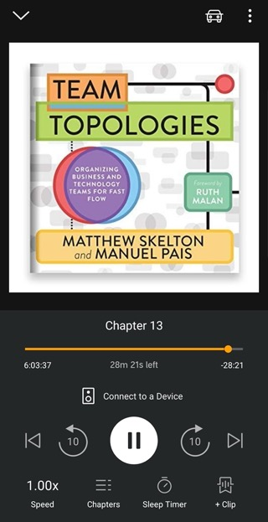

Slide 7
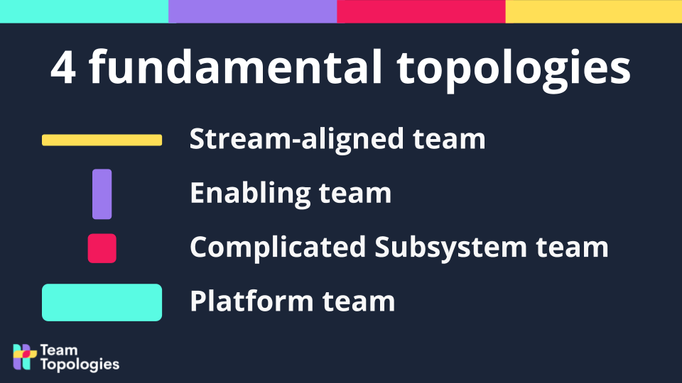
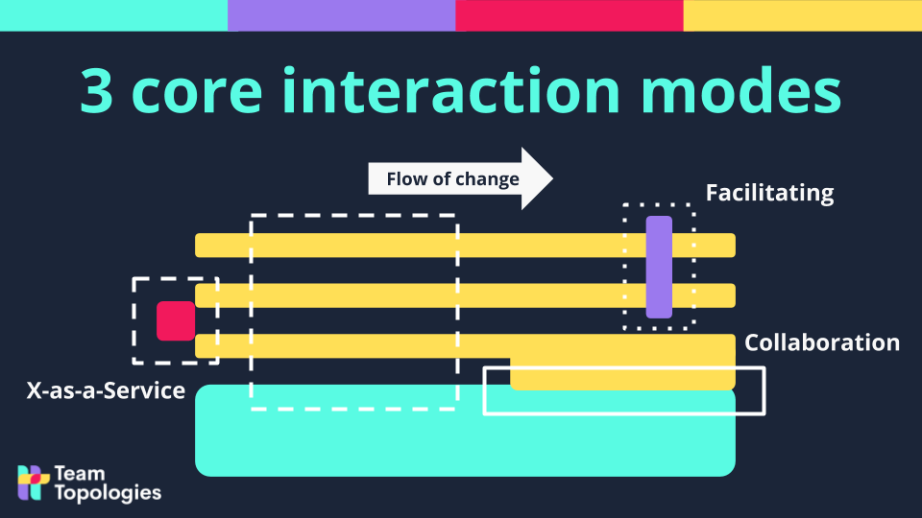
Turning Point #2
(2019.)

Slide 8
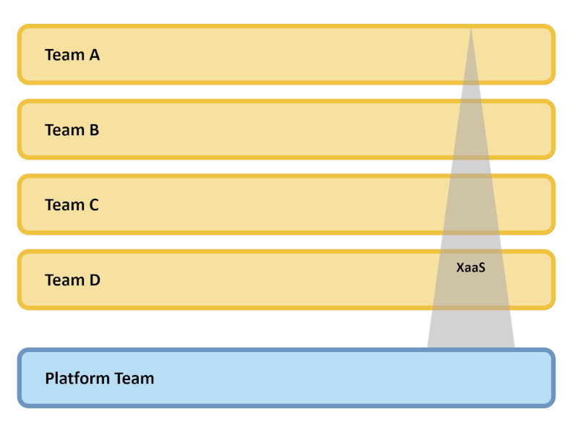
Introducing the platform team

Slide 9
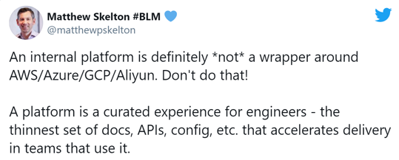
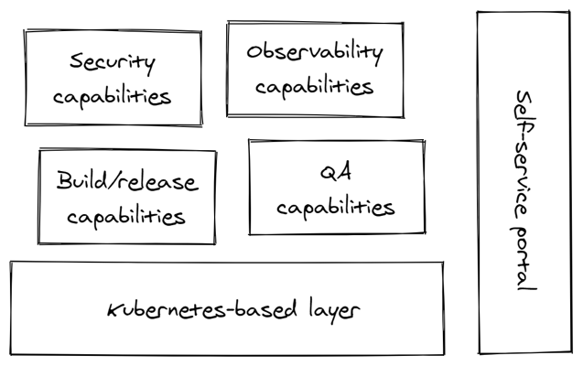
What is a platform?
Platform at CROZ

Slide 10
Evolving the platform to
support value delivery
The need to recreate and maintain runtime environment at client’s site
Automation scripts (Ansible) for installing and configuring container platform
GitOps principles using ArgoCD
The need to support client teams in automating deployments
Platform provides a basic deployment pipeline
The need to maintain and evolve application stack
Formed a special internal team called The Incubator tasked with:
Defining and evolving our standardized weapon-of-choice application stack
Onboarding and enabling junior colleagues for the stack

Slide 11
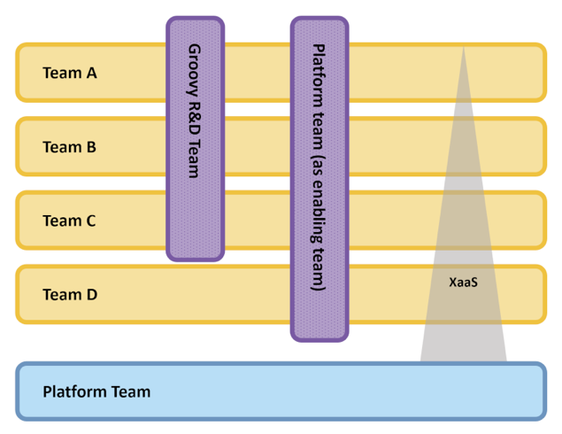
Increasing organizational capabilities with
Enabling teams
Introducing new technology in a controlled fashion
Upgrading team competencies
Suggesting platform upgrades

Slide 12
Lessons learned from a platform team
in a professional services company
Platform needs to support many more products
Platform development is partly constrained by client’s technical decisions
Platform needs to provide wider range of services
Additional cognitive load on the platform team
Who bears the cost of building the platform in a professional services company?
Professional services company helps its clients set up their platform and acts as an enabling team for the client

Slide 13
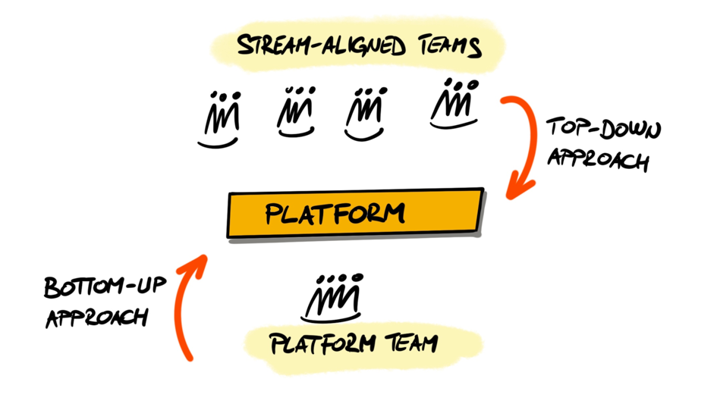
Driving the platform evolution

Slide 14

Consequences of a pure
bottom-up approach
(Real-life and very painful example)
Platform team:
“Let’s make sealed secrets mandatory, that will make our system more secure!”
Stream-aligned team:
“I don’t believe this! It’s a test environment! It takes us now 3 days instead of an hour to configure something.”
#&%!# !!!1!

Slide 15
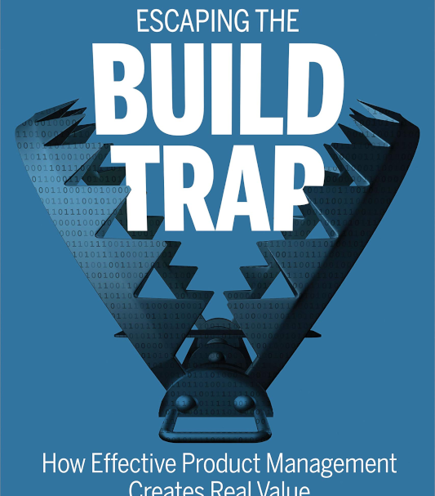
Start treating the platform as a product
Who are we building it for?
Who are our personas?
It’s a typical product management in a nutshell
Know thy users
Figure out how to make their life easier
Prioritize ruthlessly
Small steps
Short feedback loop – learn quickly

Slide 16
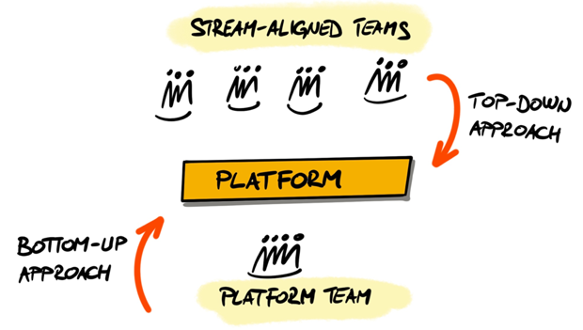
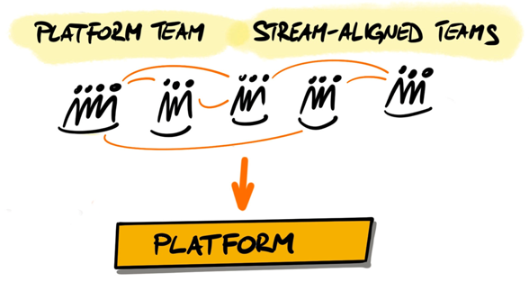

Slide 17
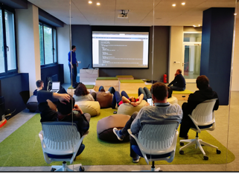
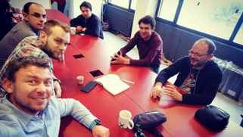

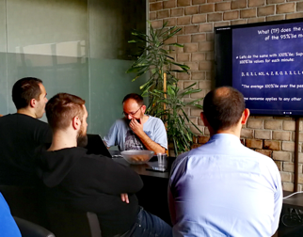
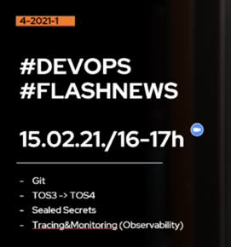
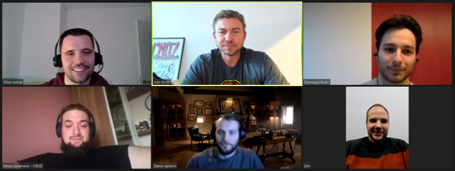
Tech Thursdays
Talking directly to teams
How does the conversation in teams and between teams happen?
Community of practice
Flashnews
Weekly team sync

Slide 18

Platform helps but it’s not a silver bullet,
what about problems like…
Maintaining long-living products over time
Retaining “vintage” tech skills in the team
Developing new engineering skills
Team member turnover
This is where the organization
and leadership kicks-in…
Photo by Tim Collins on Unsplash

Slide 19
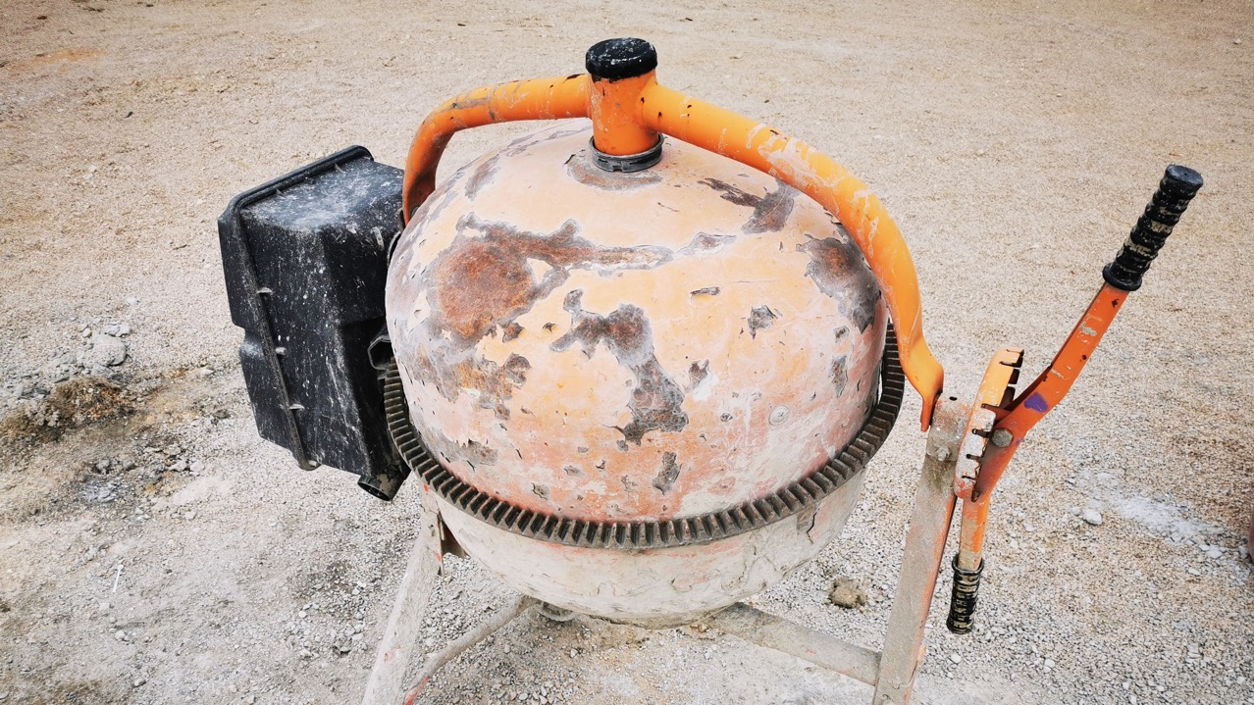
Some of the prettiest and most reliable houses I’ve seen were built in 2021 using this machine…
It’s not about tools…
It’s about vision, skills, principles, craftsmanship and the team you’re building with…

Slide 20

The results of our “experiment”
A blueprint of how our teams should be structured
Increased collaboration and knowledge sharing
Splitting the cognitive load relieved much of the pressure from stream-aligned teams and enabled them to focus better on delivering value to end users
Platform as a catalyst for change
Technical practices introduced and standardized
Increased engagement among people

Slide 21

What this meant for our business?
Revenue increased 70%
(while headcount grew only 10%)
73% of returning clients
Photo by Michal Mrozek on Unsplash

Slide 22

Where do we go from here?
Further improving self-service capabilities
Automating project resource governance
Driving new technology and capabilities through platform
Implementing Value Stream Management tool
Connecting existing portfolio management process with delivery metrics to better tune the flow
Photo by Ahmed Zayan on Unsplash

